Slide 1

19ECE204 DIGITAL ELECTRONICS AND SYSTEMS L-T-P-C: 3-1-0-4 Lecture 2

Slide 2


Binary Logic – Variables and Functions
Logic circuits with only 2 logic values is called as binary logic circuit.
The simplest binary element is a switch having 2 states
If a given switch is controlled by an input variable x,
then we can say that the switch is open if x = 0 and closed if x = 1

Slide 3
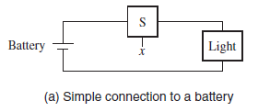
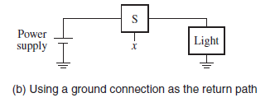
Contd.
The current flows when the switch is closed, that is, when x = 1.
The input that causes changes in the behaviour of the circuit is the switch control x.
The output is defined as the state (or condition) of the light (denoted by L).
If the light is ON => L = 1. If the light is OFF => L = 0.
Since L = 1 if x = 1 and L = 0 if x = 0,
we can say that L(x) = x
This simple logic expression describes the output as a function of the input.
We can say that L(x) = x is a logic function and that x is an input variable.

Slide 4
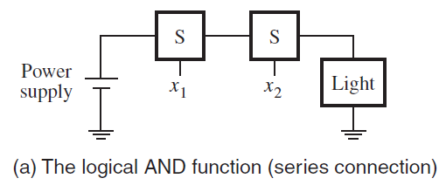
Binary Logic – Series/Parallel
Using a series connection, the light will be turned on only if both switches are closed.
This behaviour can be described by the expression,
L(x1, x2) = x1 · x2 = x1x2
where L = 1 if x1 = 1 and x2 = 1, L = 0 otherwise.
The “·” symbol is called the AND operator
The circuit in figure is said to implement a logical AND function.

Slide 5
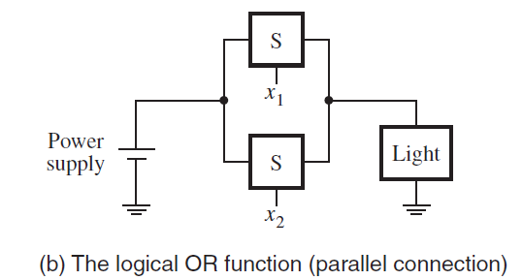
Contd.
In this case the light will be on if either the x1 or x2 switch is closed or if both switches are closed.
The light will be off only if both switches are open.
This behaviour can be stated as,
L(x1, x2) = x1 + x2
where L = 1 if x1 = 1 or x2 = 1 or if x1 = x2 = 1, L = 0 if x1 = x2 = 0.
The + symbol is called the OR operator, and the circuit implements a logical OR function.
The use of the + symbol is different from its arithmetic addition meaning.
The AND and OR functions along with other simple functions can be used to build all logic circuits.

Slide 6
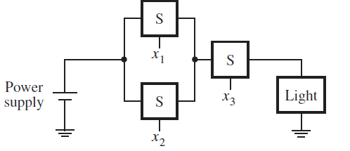
Series & Parallel
This series-parallel connection of switches realizes the logic function
L(x1, x2, x3) = (x1 + x2) · x3 = (x1 + x2) x3
The light is on if x3 = 1 and, at the same time, at least one of the x1 or x2 inputs is equal to 1.

Slide 7
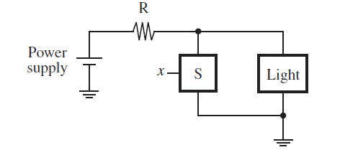
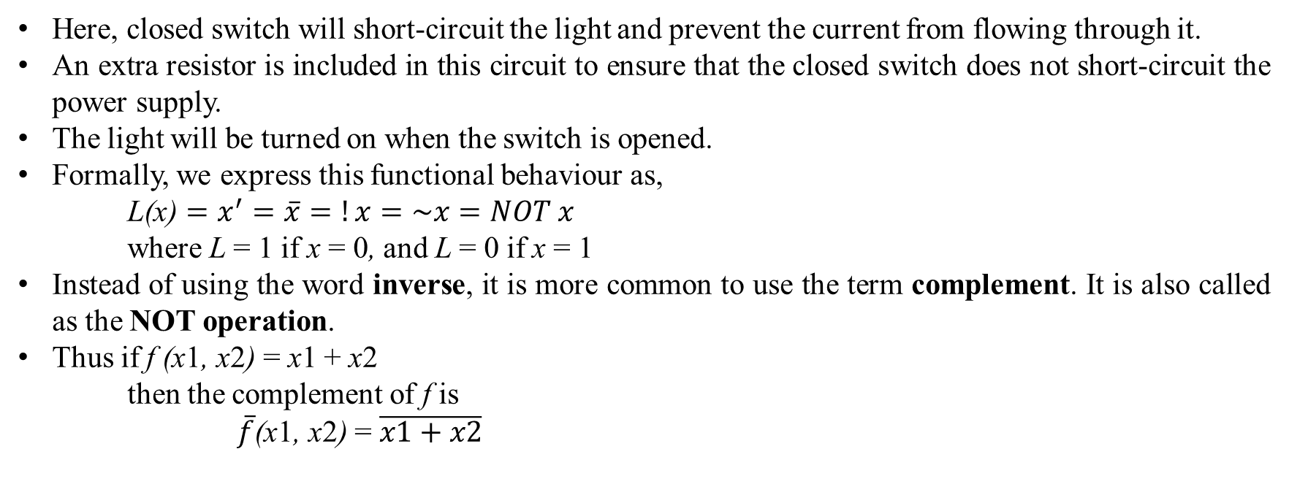
NOT operation
Here, closed switch will short-circuit the light and prevent the current from flowing through it.
An extra resistor is included in this circuit to ensure that the closed switch does not short-circuit the power supply.
The light will be turned on when the switch is opened.
Formally, we express this functional behaviour as,
L(x) $=x^{′}=\overline{x}=!x=\sim x=NOT x$
where L = 1 if x = 0, and L = 0 if x = 1
Instead of using the word inverse, it is more common to use the term complement. It is also called as the NOT operation.
Thus if f (x1, x2) = x1 + x2
then the complement of f is
$\overline{f}$(x1, x2) = $\overline{x1+x2}$

Slide 8
Truth Tables and Logic gates
AND, OR and NOT operations can also be defined in the form of a table called as a truth table
x and y are i/p variables and z is o/p variable.
The rows below x & y have all the possible combinations of logic values or ‘valuations’
AND
OR
NOT
x | y | z
0 | 0 | 0
0 | 1 | 0
1 | 0 | 0
1 | 1 | 1
x | y | z
0 | 0 | 0
0 | 1 | 1
1 | 0 | 1
1 | 1 | 1
x | z
0 | 1
1 | 0
z = x • y = x y
z = x + y
z = x = x’

Slide 9
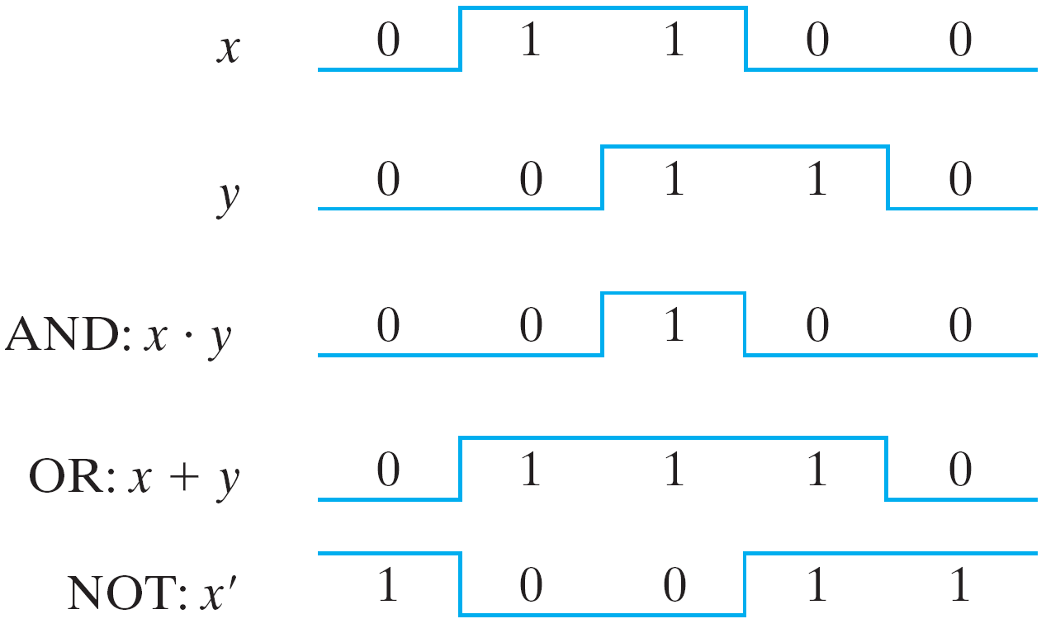
Timing Diagram
The time runs from left to right, and each input valuation is held for some fixed duration.
Such timing diagrams are useful for indicating the functional behaviour of logic circuits.
Timing Diagram (Input-Output signals for gates)

Slide 10
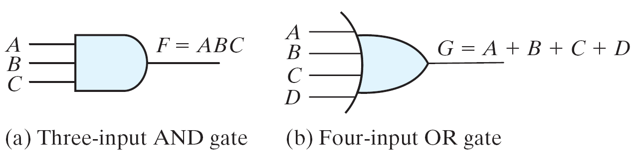
Contd.
Logic gates
Graphic Symbols and Input-Output Signals for Logic gates:
Fig. Gates with multiple inputs

Slide 11
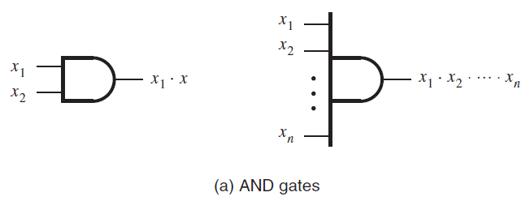
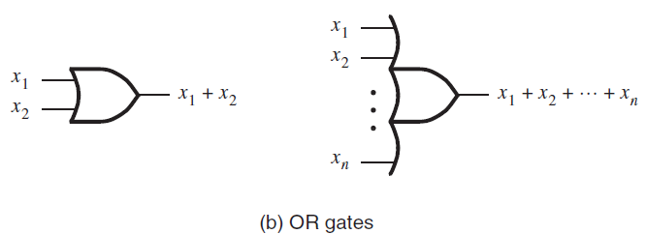
Truth Table for more input variables
A truth table for three input variables has eight rows because there are eight possible valuations of these variables.
For four input variables the truth table has 16 rows, and so on.
In general, for n input variables the truth table has 2^{n} rows.

Slide 12
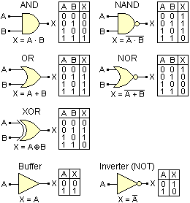

Slide 13
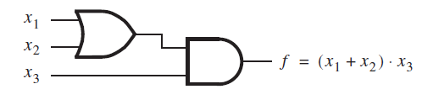
Logic Network
A larger circuit with a network of gates is often called a logic network or simply a logic circuit.
As the complexity of a given network increases, its cost increases.
The same logic function can be implemented with a number of different networks
The one with the least complexity will be the cheapest.
So, it’s the designers interest to optimize logic network for the given function from its alternatives.

Slide 14
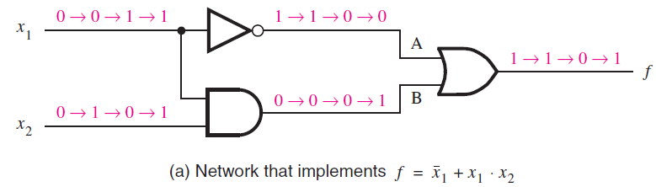
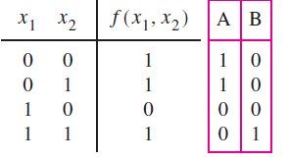
Analysis of a Logic Network
For an existing logic network, the process to determine the function performed by the network - analysis process.
The task of designing a new network that implements desired functional behaviour - the synthesis process.

Slide 15
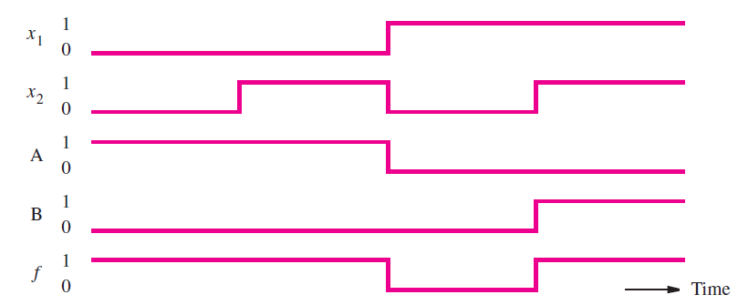
Timing Diagram
Timing diagrams are useful for indicating the functional behaviour of logic circuits.
However, practical logic gates are implemented using electronic circuits which need some time to change their states.
Thus, there is a delay between a change in input values and a corresponding change in the output value of a gate.

Slide 16
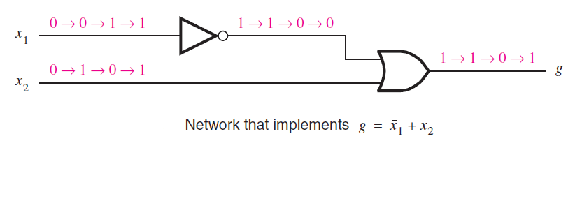

Functionally Equivalent Networks
x₁ | x₂ | g
0 | 0 | 1
0 | 1 | 1
1 | 0 | 0
1 | 1 | 1
The output g changes in exactly the same way as the previous circuit
Therefore, g(x₁, x₂) = f (x₁, x₂) => two networks are functionally equivalent
Since both networks realize the same function, it makes sense to use the simpler one, which is less costly to implement.
But, f (x₁, x₂) = $\overline{x1}$ + x₁ · x₂ and g(x1, x2) = $\overline{x1}$ + x2,
So, there must exist some rules that can be used to show the equivalence.
Truth Table

Slide 17
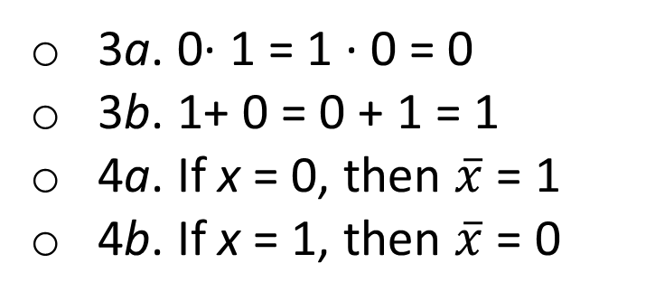
Boolean Algebra - Axioms
In 1849, George Boole published an algebraic description scheme for logical thought and reasoning processes.
In the late 1930s Claude Shannon showed that Boolean algebra provides an effective means of describing circuits built with switches.
This algebra in turn became a powerful tool to express logic circuits.
Assumptions or Axioms of Boolean Algebra
1a. 0· 0 = 0
1b. 1+ 1 = 1
2a. 1· 1 = 1
2b. 0+ 0 = 0
3a. 0· 1 = 1 · 0 = 0
3b. 1+ 0 = 0 + 1 = 1
4a. If x = 0, then $\overline{x}$ = 1
4b. If x = 1, then $\overline{x}$ = 0

Slide 18
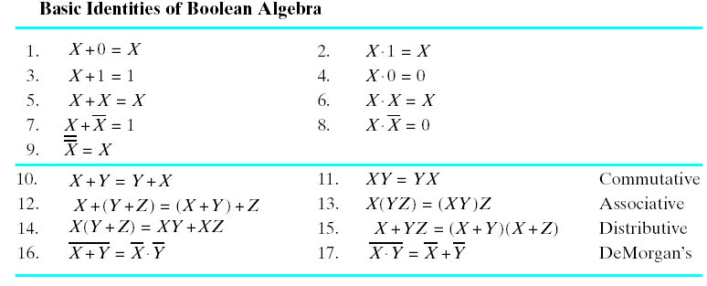
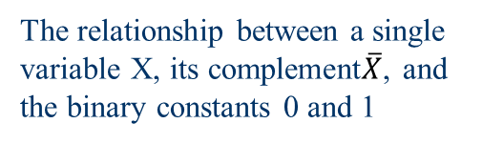
Basic Identities of Boolean Algebra
If X is a Boolean variable then,
The relationship between a single variable X, its complement$\overline{X}$, and the binary constants 0 and 1

Slide 19
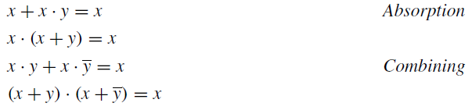
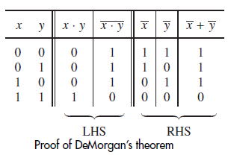
Basic Identities of Boolean Algebra - Duality
These identities can be proved by using the axioms of Boolean algebra, truth table & Venn Diagram
Given a logic expression, its dual is obtained by:
replacing all + operators with · operators, and vice versa, and
by replacing all 0s with 1s, and vice versa.
The dual of any true statement (axiom or theorem) in Boolean algebra is also a true statement.

